Slide 1
An educational prescription for strengthening health care in changing times
CFPC Outcomes of Training Project
Spring 2023 Update
www.cfpc.ca/futurefp
Notes:
This presentation provides an overview and current update regarding the CFPC’s Outcomes of Training Project (OTP) and the recommended changes to family medicine residency training. Many are trying to understand why these changes are happening and so we hope to advance this conversation.

Slide 2
We must invest in education now
We need comprehensive family physicians. This will require transformative change.
Education is a pre-condition for success. If we want a different system in the future, we must invest in education now.
Notes:
CRITICAL CONTEXT:
The OTP is committed to being part of and influencing the bigger picture of health system transformation and improving the family practice environment in Canada
Many Canadians are without access to care. It is not just a numbers issue but one regarding health workforce capacity
As part of our educational goals, the CFPC wants to optimize what family physicians can do as part of a transformed health system
Education matters because it supports change
This is urgent. If we want a different system in the future, we must invest in educational changes now

Slide 3
Burnout is prevalent among family physicians
The CFPC advocates for health system change
Education is a pre-condition for successful health system transformation
Support for sustainable practice and compassionate self-care starts in residency
Notes:
CRITICAL CONTEXT:
Family physicians are facing alarming rates of burnout, and many are reducing, or modifying their clinical hours, retiring early, or leaving the profession altogether.
Along with improving practice conditions, it is important that family physicians are supported to work sustainably as part of a primary care team and across different environments starting in residency
Feeling better prepared and supported in the transition to practice will promote professional well-being and satisfaction

Slide 4
What?
(is the Outcomes of Training Project))
In 2018 the College of Family Physicians of Canada (CFPC) commissioned the Outcomes of Training Project (OTP) as a critical review of family medicine residency training during dynamically changing times and challenges to the discipline. The purpose was to clarify the intended goals and outcomes of training, and to determine if and how training must evolve to meet societal needs.
Notes:
Summary statement provided on slide

Slide 5
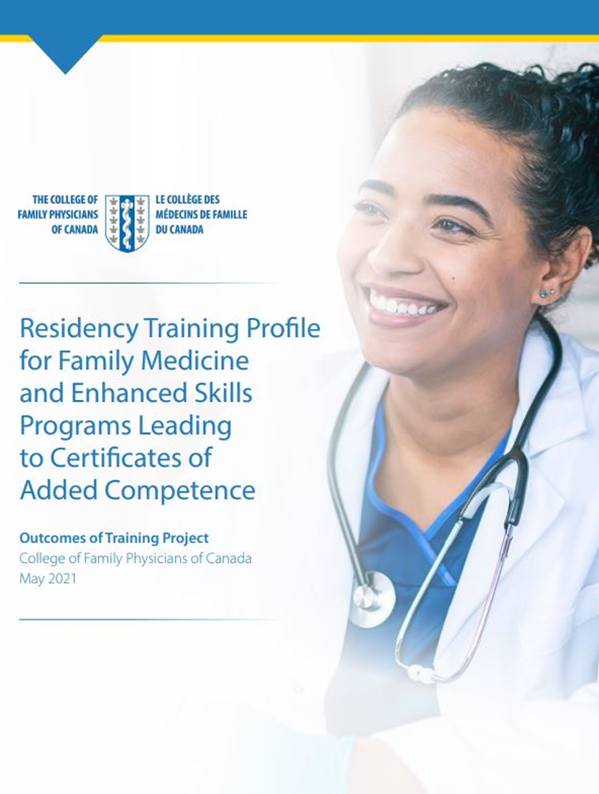
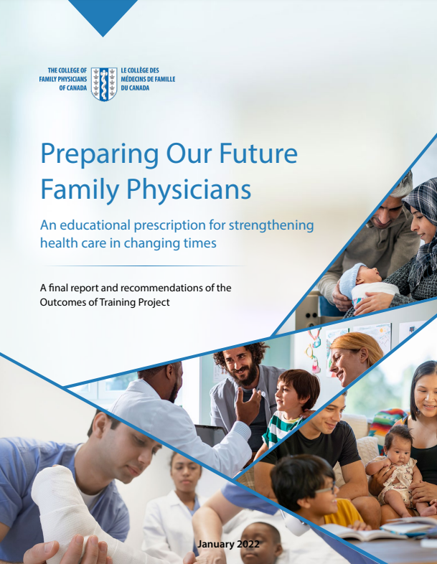
Project Outline
PHASE 1. Analysis & Recommendations (Complete)
What are we aiming for in residency training? Residency Training Profile
How are we doing it? A critical examination of current training. Evidence summaries.
Where are we going? Synthesis of findings and educational recommendations. Final report.
PHASE 2. Curriculum Renewal & Change Stewardship
The Education Reform Taskforce is guiding implementation of the educational recommendations.
Education Development & Design. What does a three-year renewed curriculum look like?
Change Stewardship Plan. Partner engagement and assessment of change readiness, risk and feasibility.
Education Evaluation Strategy. What does success look like and how would we know?
Notes:
The OTP is carried out in two phases
We have completed the first phase resulting in our analysis and educational recommendations and are now at the beginning of the second phase focusing on curriculum planning and change stewardship
This includes examining what a renewed curriculum looks like and how to support the implementation of this complex change in a responsible way

Slide 6
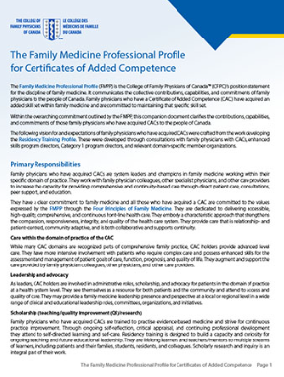
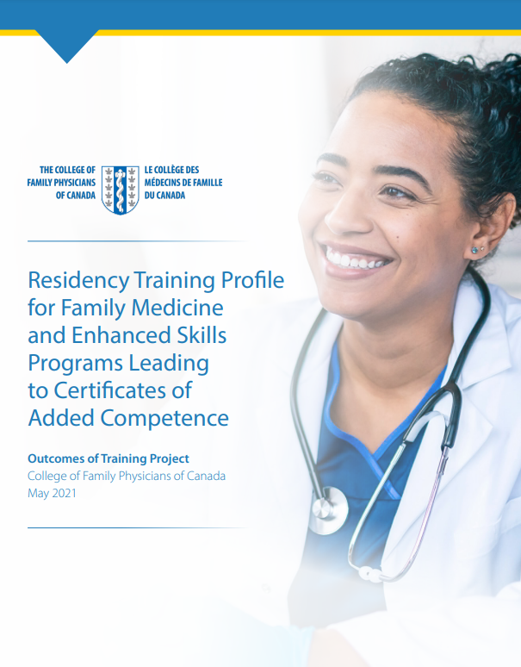
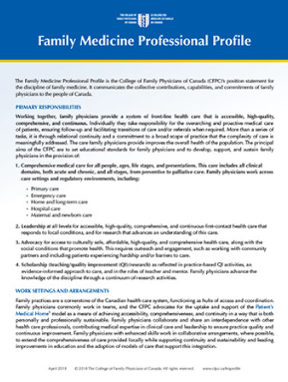
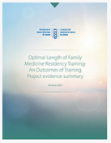
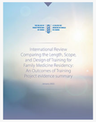
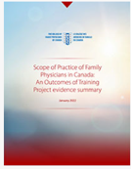
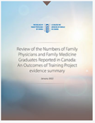
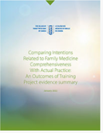
Project Roadmap – Phase 1 (complete)
Phase 1 – Strategy
Problem
Who are the family physicians that Canada needs now and into the future?
1a. Discover
What are we aiming for in family medicine residency training?
1b. Define
How are we doing relative to this?
Problem Definition
Where are we going?
Family Medicine Professional Profile
The Family Medicine Professional Profile for Certificates of Added Competence (CAC)
The Residency Training Profile for Family Medicine and Enhanced Skills Programs Leading to CACs
Evidence Summaries Series
Preparing Our Future Family Physicians (A final report and recommendations of the OTP)
Notes:
DEEPER DIVE –FIRST PHASE:
The first phase of the project resulted in the Residency Training Profile, which:
Defines comprehensiveness in training (scope of training) as an approach to care as well as a set of Core Professional Activities (CPAs) for which graduates will be prepared
Incorporates CPAs that reflect the changing role of family physicians
Incorporates new activities and skills that reflects changing societal needs
The final report outlines our analysis of current training and offers recommendations for changes that will:
Enable adoption of the Residency Training Profile
Support continuous quality improvements in education

Slide 7
Summary of Analysis
Canadian family medicine training must be very broad to prepare for diverse settings in keeping with national certification
Graduates are not consistently prepared to practice anywhere in Canada, nor do they feel prepared to practice within all areas of training (this limits practice opportunities for some)
There are curriculum gaps in key areas
Societal needs are changing with new skills required
New skills required to integrate medical advances and new technologies
But the curriculum is full. This should come as no surprise. Canada has the broadest scope and shortest training in the world.
Notes:
Our analysis tells us that educational enhancements are required because:
Comprehensive care in Canada requires graduates to have a very broad foundation to enable practice in a diversity of settings. This is now defined clearly by the Residency Training Profile
Many graduates do not feel adequately prepared to practice comprehensively, particularly in some domains (e.g., acute and procedural care)
This influences where they can go and what they can do upon graduation
There are curriculum gaps in important areas such as home and long-term care, Indigenous health, and care for underserved populations
Societal needs are changing, and family physicians need more skill in caring for patients with multiple morbidities and in specific areas such as addiction and mental health (complexity care)
There is a societal imperative for care that is culturally safe and anti-racist so new/enhanced skills are required
New/enhanced skills are also needed due to medical advances and new technologies, notably for virtual care and informatics and how to integrate those in primary care

Slide 8
Summary of Recommendations
Implement the Residency Training Profile for core family medicine
Implement the Residency Training Profile for CAC-related enhanced skills
Establish a national cycle of educational evaluation for improvement
Enhance family physician skills in priority areas:
Home and long-term care
Addiction and mental health
Emergency/acute care medicine
Indigenous health
Health equity and anti-racism
Virtual care and health informatics
Notes:
Here is a summary of our educational recommendations, each of which come with enabling actions
Most notably, in order to adopt the Residency Training Profile, it is recommended that the length of core training be increased to three years

Slide 9
This will result in graduates who are…
Working Top of Scope
As part of a primary care team, providing collaborative leadership for changing and complex patient care needs.
Fully Prepared
To enter and adapt to comprehensive family practice anywhere in Canada.
Making a Difference
With new skills to meet societal needs and care for underserved populations.
Well and Satisfied
Working sustainably with improved professional satisfaction.
Notes:
Here are our national curriculum renewal goals for core training:
COMPREHENSIVENESS: We want all residents trained to the full scope of the profession
PREPAREDNESS: We want graduates who are prepared to “hit the ground running”; confidant and capable of comprehensive family practice anywhere in Canada
MAKING A DIFFERENCE: We want graduates capable of making a difference in the lives of their communities, with skill and motivation for working with underserved populations.
PROFESSIONAL WELL-BEING: We want our graduates to work sustainably and at the top of their scope, as part of a team, with improved well-being and professional satisfaction

Slide 10
Why?
(extend training))
In a competency-based paradigm, time is a resource. Extending training in family medicine will allow for needed new and strengthened learning experiences.
Notes:
To help us address the crisis in family medicine, we need more comprehensive care physicians with the skills and knowledge to work in interprofessional teams and the PMH vision.
Family doctors will need to adapt to a transforming health care system. This will include new and optimized skill sets.
This will require a different approach to education and training for family doctors.
The CFPC’s OTP aims to address this by:
Optimizing the scope of training to support comprehensive practice
Changing the practice environment so students can learn how to work more sustainably as part of an interprofessional team
Strengthening residency training so family medicine graduates are prepared to manage the comprehensive, complex, and evolving needs of all patients in Canada across diverse practice environments ​

Slide 11
Other options:
These options were considered:
Status quo – no increase in time
Flexible – customized increase in time based on individual learning needs
Fixed – increase in time to three years. This option accommodates the proposed enhancements to allow comprehensiveness in training
Notes:
In the process of deciding to recommend an increase in the length of training, other options were developed and considered in consultation with various interested parties. Here are the options that were considered.

Slide 12
Consultation:
Consultation with subject matter experts took place regarding the options.
Subject matter experts included:
University department heads
Residency program directors
CFPC Section of Residents
CFPC Section of Medical Students
CFPC First Five Years in Family Practice group
Notes:
Here are the groups that were consulted. They are knowledgeable in the resources required for running a residency program and/or have current experience with today’s curriculum.

Slide 13
Strengthening Training
Preparing future family physicians for comprehensive practice now and in the future.
A fixed increase to three years was recommended by the CFPC Family Medicine Specialty Committee and approved by the CFPC Board of Directors
The scope of change required (form and function)
Makes enhancements mandatory not optional
More feasible and less expensive to administer
Enables programs to plan for service commitments with hospitals and communities
Less stigma for learners: ‘normalizes needing more time’
Easier to explain and plan for policy makers and funders
Inline with other countries from international review
Notes:
These were the main reasons influencing the CFPC’s Family Medicine Specialty Committee recommended increase to three years. This was then supported and approved by the CFPC Board of Directors in late 2021.

Slide 14
How and When?
(will changes occur))
The CFPC has not yet changed educational standards and won’t until a way forward is clear, not earlier than 2027. We are committed to a responsible and collaborative change approach, incremental and iterative, and coupled with evaluation.
Notes:
There have been no changes made to the CFPC’s educational standards yet and this will happen no sooner than 2027
CFPC is committed to this direction but recognizes the complexity of proposed changes
CFPC is committed to a responsible, collaborative and systems change approach
Decision making about changes to educational standards will be iterative, incremental and based on developmental evaluation
Change cannot happen all at once and will be introduced gradually to offset the potential impact of a reduced number of graduates entering the system

Slide 15
Project Roadmap - Phase 2 (under way)
Phase 2 – Execution
2a. Develop
How will we get there?
2b. Deliver
When will we get there? How will we know we made it?
Educational Outcome
March 2024
2024–2027
2030: First Graduates
Curriculum Renewal
Change Stewardship
Planning for Implementation
National evaluation will be established to monitor:
Team Primary Care is transforming how primary care providers train to work together
Outcomes Evaluation
Developmental Evaluation
Graduate preparedness and competence in new skill areas
Family physicians mix, scope, and distribution
Family physician well-being and satisfaction
Family physician’s opportunity to work in supported, team-based care models
Notes:
We’re currently early in the second phase of work, focused on curriculum renewal and change management:
These efforts are supported until March 2024 as part of a large federal initiative called “Team Primary Care”
By March 2024 each school (Department of Family Medicine) has been asked to develop a Curriculum Renewal Plan and a Change Readiness Assessment.
By March 2024 we anticipate having a national snapshot of change readiness and a better idea of what the new curriculum will look like.
With this information the CFPC can make informed decisions about the implementation of changes to the standards of accreditation and certification in family medicine.
We hope that by 2027, many programs will be able to offer a renewed curriculum in at least one or more program sites (existing or expansion sites)
So by 2030 we will start to have some graduates from the renewed curriculum and will begin evaluating outcomes

Slide 16
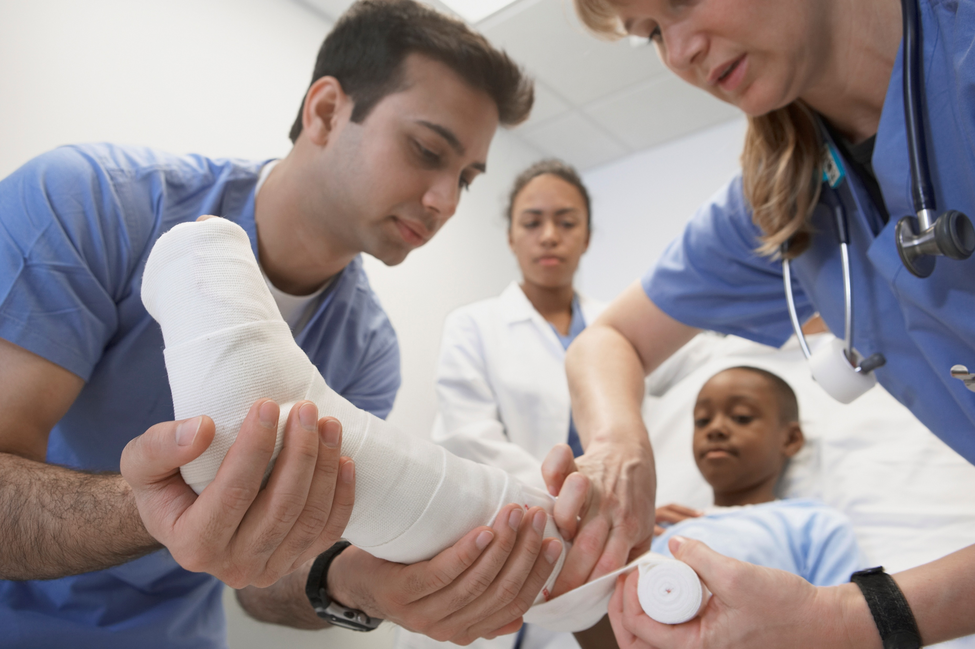
What about enhanced skills training?
Renewed focus on advanced practice and leadership in specific domains
Extra time not intended to result in Certificates of Added Competence (CACs) for all, but may shorten a CAC-related program
OTP phase two will also look at changes to enhanced skill training, with more information by March 2024
Notes:
It is important to reset the message to learners about the purpose of enhanced skill training
It is not intended for core skills consolidation
It’s to achieve advanced practice and leadership
It’s also to enable function as a consultant and teacher, supporting colleagues in the delivery of comprehensive family practice
We do not yet know exactly what the new paradigm for enhanced skills program will look like but this is part of the planning that is currently taking place
We know now that in a renewed curriculum it will take more than three years to obtain a CAC – it is above and beyond what can be accomplished in core training

Slide 17
Connect for additional resources and information
Project website: www.cfpc.ca/futurefp
Project team email: academicfm@cfpc.ca

